Slide 1
A View from the Trans* Bridge:
New Understandings of Gender for Everyone
Reunion 2019: Michelle Dayna Allison LMFT, Class of 1964
Notes:
The Trans* Bridge: Arthur Miller 1955. Brooklyn Bridge, bridge between old world/immigrant culture and a more open post war America
My perspective; Trans—crossing the seemingly dramatic chasm of understanding: the gender divide;
Psychotherapeutic: what are the origins of our suffering and how to heal are wounded hearts.

Slide 2
This being human is a guest house.
Every morning a new arrival.
A joy, a depression, a meanness
Some momentary awareness comes as an unexpected visitor.
Welcome and entertain them all!
Even if they're a crowd of sorrows,
Who violently sweep your house empty of its furniture,
Still, treat each guest honorably.
He may be clearing you out for some new delight.
The dark thought, the shame, the malice,
Meet them at the door laughing, and invite them in.
Be grateful for whoever comes,
Because each has been sent as a guide from beyond.

Slide 3
Some questions Michelle Allison frequently ponders:
Do we really know what we mean by ‘sex’ and ‘gender’?
Is ‘sex’ completely biological and ‘gender’ a purely social construction?
How is ‘gender politics’ shaping our social cohesion? What are the prospects for America to become whole?
Is there an ‘essential’ nature or even a set of traits defining female and a male so that we can generalize?
Are feminists right about the corrosive impact of ‘patriarchy’?
How are men faring emotionally? Does psychotherapy have anything useful to offer men? ? Is ‘male fragility’ a valid or useful notion?
Having experienced both genders, what have I personally leaned about our gendered lives that is clinically relevant?
Notes:
Edsall (NYT,1-19): The Fight Over Men is Shaping or Political Future
The predictable political fault lines: Women still have obstacles(D=73%,R+34%); done enough for women (D=26%,R=54%); changing gender roles improve marriage (D=47,R=26%)
We know the voting patterns of men and women are dramatically divergent; what meaning for this topic
The personal is political,” said the second-wavers. popularized by Carol Hanisch.1969) problems that seemed to be individual and petty — about sex, and relationships, and access to abortions, and domestic labor — were in fact systemic and political, and fundamental to the fight for women’s equality.
Ability to generalize: Can we say: ‘Traditional Masculinity’ or ‘Transgender Experience

Slide 4
Constructs That Will Be ‘Bandied About’ Today
Cisgender: refers to people whose sex assigned at birth is aligned with their gender identity : ‘Cis’ for short.
Transgender: persons whose experienced gender is at variance from the gender assigned at birth: ‘Trans’ is my preference
Gender non-conforming, non-binary, ‘gender queer’: persons whose gender identity does not align with either female or male
Queer: describes a person whose sexual orientation is not heterosexual and/or whose gender identity is not cisgender
Gender Role/Expression: social behaviors, mannerisms, interests, and styles of dress: social presentation, perhaps ‘performance’
Intersectionality: describes the way that multiple systems of oppression interact in the lives of those with multiple marginalized identities.
Privilege: unearned sources of social status, power, and institutionalized advantage experienced by individuals by virtue of their culturally valued and dominant social identities
Notes:
“Queer’ is a reclaimed word: feel free to use it (as an adjective, not a noun, please)
I don’t have explain the difference between sexual orientation and gender identity. Do I?
Non-binary people have to truly ‘invent’ their gender identity—they have no ‘off the shelf’ version
Non binary pronouns: they, them— we already often use these pronouns in a singular way without non-binary reference. Grammarians please get over worrying about this!
Judith Butler: gender as performativity—largely a philosophical argument, in keeping with Critical Theory—my view is this best describes gender role expression
Butler’s goal is largely political; to be able say both sex and gender are effectively social constructions. This undercuts any efforts to privilege sexist viewpoints, insure civil liberties, etc
Intersectionality: race is the most powerful dimension for marginalization. I will talk about race and privilege today, oh yeah!

Slide 5
Unmarked versus Marked Traits
Groups who are dominant or the majority are typically viewed as ‘unmarked’ -- i.e., their existence and perspectives are taken for granted, and deemed an unquestionable norm.
Minority and marginalized groups become ‘marked’ in comparison -- they seem remarkable and tend to stand out, garnering undue attention and scrutiny; they are also likely to be viewed as inherently questionable, suspicious, alien, exotic, abnormal, artificial, or deceptive.
People who are ‘marked’ are generally viewed as having ‘something' that unmarked people do not have, and this ‘something’ is subsequently subjected to all sorts of comments, questions, critiques, debates, and double-binds that the unmarked person escapes.
Unmarked/marked distinction plays a role in all -isms, where it provides the unmarked group with countless privileges that they are typically unaware of (due to their unmarked, and therefore seemingly invisible, nature).
Notes:
From linguistics, one kind of explanation of how discrimination, dominance and exclusion come to be. A better explanation than Original Sin or a domination gene.
Physicians/psychiatrists refer to a mental status exam as ‘unremarkable’
The group that does the marking of a marginalized group drives this process:
whites mark blacks
men mark women
cis people mark trans people
straight people mark gay people
Christians mark Muslims (in Western Xian countries)

Slide 6
An unpleasant, self conscious emotion:
typically associated with a negative evaluation of the self,
\\\\\\\\\\\\\\\\\\\\\\\\\\\\\\\\\\\\\\\\\\\\\\\\\\\\\\\\\\\\\\\\\\\\\\\\\\\\\\\\\\\\\\\\\\\\\\\\\\\\\\\\\\\\\\\\\\\\\\\\\\\\\\\\\\\\\\\\\\\\\\\\\\\\\\\\\\\\\\\\\\\\\\\\\\\\\\\\\\\\\\\\\\\\\\\\\\\\\\\\\\\\\\\\\\\\\\\\\\\\\\\\\\\\\\\\\\\\\\\\\\\\\\\\\\\\\\\\\\\\\\\\\\\\\\\\\\\\\\\\\\\\\\\\\\\\\\\\\
\\\\\\\\\\\\\\\\\\\\\\\\\\\\\\\\\\\\\\\\\\\\\\\\\\\\\\\\\\\\\\\\\\\\\\\\\\\\\\\\\\\\\\\\\\\\\\\\\\\\\\\\\\\\\\\\\\\\\\\\\\\\\\\\\\\\\\\\\\\\\\\\\\\\\\\\\\\\\\\\\\\\\\\\\\\\\\\\\\\\\\\\\\\\\\\\\\\\\\\\\\\\\\\\\\\\\\\\\\\\\\\\\\\\\\\\\\\\\\\\\\\\\\\\\\\\\\\\\\\\\\\\\\\\\\\\\\\\\\\\\\\\\\\\\\\\\\\\\\\\\\\\\\\\\\\\\\\\\\\\\\\\\\\\\\\\\\\\\\\\\\\\\\\\\\\\
feelings of distress, exposure, mistrust, powerlessness and worthlessness
An unrealistic sense of superiority, a sustained view of oneself as superior to others that causes one to view others with disdain or as inferior due to a variety of personal characteristics
Grandiosity
Boundaryless
Walled off
Shame
An unpleasant, self conscious emotion:
typically associated with a negative evaluation of the self; feelings of distress, exposure, mistrust, powerlessness and worthlessness
Notes:
Shame and its analog, grandiosity derive from emotional fragility: an insufficient sense of consolidated and grounded self hood.
In other language, an outcome of psychological impairments to the ‘soul’
Bifurcations of the self, the loss of wholeness and unity

Slide 7
Racism: an implicit ideology rationalizing racial hierarchies: -whites are the norm or standard for humans -people of color are a deviation from that norm
White Fragility: a reflexive, largely unconscious response produced/ sustained by continual social and material advantages of whiteness.
When white fragility is triggered, emotional disequilibrium occurs Anger toward the trigger leads white people to these responses: -shutting down, exiting or tuning out -indulging in emotional incapacitation: guilt or hurt feelings -describing their experience as abusive, traumatic or violent
Typical ‘nice’ white responses to conversations about race : -I’m a good person with good intentions, therefore I can’t be racist -You’re playing the race card -I’m being misunderstood -I’m not feeling safe (meaning not feeling comfortable) -The tone of this conversation is wrong (too personally challenging) -There needs to be trust for feedback to occur (I need you to trust I am not a racist before I can work on my racism)
Notes:
Robin Diangelo: “White Fragility—Why It’s So Hard for White People To Talk About Racism” (2018)
Paul of Tarsus: full of smug self consciousness and a confident worldview regarding what I think of know about race
‘Nice’ white people: liberal, progressive, not bigots, white supremacists, Charlottesville types
White fragility follows from whites being unable to recognize and accept the structural and systemic aspects of racism, which are not necessarily based on individual actions or attitudes

Slide 8
The Psychology of Racism and White Fragility
The Central Tasks for White People:
Develop Racial Stamina:
Grapple with how racist ideology and socialization shapes our responses when we are challenged about racism.
Overcome our reluctance to acknowledge our racial advantage
Stop seeing ourselves as individuals who are exempt from the forces of racial socialization and implicit bias
Give up the binary that ‘good’=non-racist, while ‘bad’=racist
Don’t use ‘Color Blind’ and ‘Color Celebrate’ narratives to take race off the table: a racist free upbringing is not possible
Don’t claim that challenging racist behavior is more problematic than racist behavior itself
Notes:
White fragility is an example of the experience of shame catapulting a person to defensive, condescending grandiosity to avoid the pain of acknowledging shame
Color Blind: “i don’t see race or color—I treat everyone the same
Color Celebrate: I value black people; I have friends or family who are of color; I admire and am impressed by the black people I know or see in the culture
The good—bad binary: the good news is that our racism does not make us morally bad; it makes of people who need to accept responsibility for our role in racist culture and tells us to be humble and open to learning while acknowledging uncomfortable truths about our racist society.

Slide 9
An Expression of Emotional Accountability
There is no face to save and the game is up. I know I have blindspots and unconscious investments in the status quo.
I did not set this system up, but it is does unfairly benefit me. I do use it to my advantage, and I am responsible for interrupting it.
I need to work hard to change my role in the system, but I can’t do it alone. Therefore, I am grateful when others help me.
Feedback from others is the key to recognize and repair our inevitable and often unaware collusion. How, when and where you give me feedback is irrelevant.
It is feedback I want and feedback I need. Understanding is that is hard for you to give, I will take it in any way I can get it.
From my position of social, cultural and institutional power, I am perfectly safe and I can handle it. If I cannot handle it, it’s on me to build up my ***** emotional stamina.
Thank you
Notes:
Please remember the tone and substance of this response. It will return when we discuss reparative work around gender and masculinity
Dan Harper apology: a gendered example of accountability and saying in shame rather than moving to grandiosity

Slide 10
APA (2018): Guidelines for Treatment of Men and Boys
defines‘Traditional’ Masculinity’
“… as emotional stoicism, homophobia, not showing vulnerability, self-reliance and competitiveness” which leads to the disproportion of males involved in “aggression and violence as a means to resolve interpersonal conflict” as well as “substance abuse, incarceration, and early mortality.”
Cost of maintaining male power and privilege:
Restricts men’s ability to function adaptively
Men commit 90% of the homicides in the US
Represent 77% of homicide victims
3.5% more likely to die of suicide than women
Life span is 4.9 years shorter than women
Substance abuse rates three times higher than women
Negative emotional reactions to unemployment, divorce
Reluctance to seek self care: preventive medical, mental health
Notes:
David French (national Review): APA discounts traditional male positives: ‘grown man’ — physically and mentally tough, rise to a physical challenge, show leadership under stress (a deeply felt need), and able exhibit self control (push back against stoicism)
Agrees men are not doing well; claims the cause is the suppression of essential male nature. Men are not allowed ‘to be yourself’.
Also a new economy that doesn’t naturally favor physical strength and physical courage.
Acknowledges some fathers are cruelty as a teaching tool; others are intolerant of differences; reject or bully boys who don’t measure up to masculine norms
Takes inherent characteristics: aggression, sense of adventure, default physical strength — shaping them toward virtuous ends

Slide 11
“
A Feminist Critique of:“…imperialist white supremacist capitalist patriarchy”
Both males and females are socialized into this system. Men are not the enemy.
Underlying principles of patriarchy: domination, separation and control. Values 'self-control' and frowns on ‘emotionality’
Patriarchy socializes men to deny feelings, dooming them to emotional numbness.
Social power is awarded to conformity to masculine norms, while aberrant gendered behavior is punished through gender policing.
The desire for power precludes the formation of loving, healthy relationships. To know love we must let go of the will to dominate.
Any time a male dares to transgress patriarchal boundaries in order to love, the lives of women and children are changed for the better.
Notes:
From Bell Hooks: The Will to Change—Men, Masculinity and Love, 2002
Defines the ‘male’ problem as a broader social problem impacting men and women: patriarchy Uses ‘patriarchy’ in lieu of ‘sexism’
Men have a rich emotional life; the problem is that expression of said emotions (with the exception of anger) is generally not permitted
Emphasis on love, positive interpersonal dynamics
The domination and exploitation of nature is taken for granted.
This cultural ethos explains our seeming inability to accept responsibility for the degradation of the environment and therefore to address current environmental problems

Slide 12
Feminist Masculinity
A revolutionary act of visionary feminism is to restore masculinity as an ethical biological category divorced from the dominator model.
If the desire for power remains paramount, loving, healthy relationships cannot exist.
When culture is based on the dominator model, not only will it be violent, but it will frame all relationships as power snuggles.
Men need new models for self assertion that do not require the construction of the ‘other’ as the enemy.
Rather than assuming that men are born with a will to aggress, this new culture would assume men are born with the will to ‘connect’.
Strength is needs to be redefined: it is no longer ‘power over’ but the capacity to be responsible for self and to others .
Men become more real through the act of connecting with others.
Notes:
Power, domination versus love, connection
Broader implications of seeing ‘the other (women, blacks, Muslims, LBGTQ) as enemies

Slide 13
Commonplace, but problematic definitions of sex and gender
Sex: referring to biological (typically genetic/chromosomal) aspects of being male or female: ‘nature’
Gender: the psychological, social, and cultural experiences and characteristics of males and females: ‘social construction’
H.R. 2796:(2017) prohibits the words sex or gender from being interpreted to mean gender identity; requires man or woman to be interpreted to refer exclusively to a person's genetic sex.
HHS—official Federal policy as of 5-24-19 proposes a uniform definition of gender as determined “on a biological basis that is clear, grounded in science, objective and administrable.”
Proposed definition defines sex as either male or female, based on immutable biological traits; unchangeable, determined by the genitals that a person is born with.
Notes:
Conflates sex and gender; if they are the same then making sex purely biological undermines gender as a separate construct
The political goal is to deny the option of people with gender variant identity having legal status.
On May 24th (nine days ago), the Federal government (HSS) formally made the recommendations in the 2018 memo a reality.
The cruelty of denying trans people access to healthcare to address a medically necessary problem

Slide 14
The Biological Basis of Sex and Gender
Sex is purely biological; gender is purely a social construction: NO!
Sex is a collection of sexually dimorphic traits that are variable
Even chromosomes are variable: there are thirty-five recognized variations of developmental sex disorders (intersex), some of which have anomalous chromosomes and complex gene functioning
Trans people can, and do change their sexual traits through cross gender hormones and gender affirming surgeries
‘Female’ and ‘male’ are umbrella terms describing groupings of people who generally share many of the same traits, but with considerable variability and exceptions
Sex differentiation (body and genitalia) happens earlier; gender identity occurs later, in the second half of pregnancy
The brain is sexual and variable: transgender people have brain structures midway between cis male and cis female brains
Gender identity has a neural dimension and exists on a spectrum
Notes:
Sex is biological but it is variable and is not confined to make and female; it is not a rigidly inclusive term; ‘gender’ has biological elements, but also significant social elements as well, esp. ‘expression’
The biological aspect of gender and gender identity are important: gender identity is deeply felt, probably originating in parts of the mid brain
As brain based, it has ‘biological credibility’ so to speak: as a ‘medical’ problem it has legitimacy

Slide 15
ICD 10: HA60—Gender Incongruence of Adolescence or Adulthood
or DSM 5: F64.1: Gender Dysphoria
A marked and persistent incongruence between an individuals experienced gender and the assigned sex:
1) a strong dislike or discomfort with the one’s primary or secondary sex characteristics due to their incongruity with the experienced gender
2) a strong desire to be rid of some or all of one’s primary and/or secondary sex characteristics due to their incongruity with the experienced gender
3) a strong desire to have the primary and/or secondary sex characteristics of the experienced gender
The individual experiences a strong desire to be treated (to live and be accepted) as a person of the experienced gender. The gender incongruence been continuously present for several months. The diagnosis cannot be assigned prior the onset of puberty.
Notes:
These are the medical definitions of gender variance; provide justification for treatments based on medical necessity;
It’s real/valid. I use it all the time to get paid; I got identity papers as well
Down sides are that GD lives in a mental health compendiums of disorders (was a d.o. in DSM-IV)
Also means without medical intervention a person is disqualified from legal gender change: the ‘doctor’ letter
The CT prison/penis episode

Slide 16
Impact of Cross Gender Hormone Treatment: HRT
Feminizing : estrogen
Decreased muscle mass/strength
Body fat redistribution
Softening of the skin
Breast growth
Body/facial hair: thinning/ slowed growth
Male pattern baldness: arrested, but no regrowth
Male sexuality suppression: erectile function, sperm production, decreased libido
Masculinizing: testosterone “T”
Facial/body hair growth
Scalp hair loss
Deepened voice
Increased muscle mass/strength
Body fat redistribution
Cessation of menses
Clitoral enlargement
Vaginal atrophy
Notes:
These are the bodily changes: secondary sex characteristics; things that happen in puberty
The most important change is emotional and experiential
All trans experience confirms that a powerful (but not exclusive) pathway into authentic, existential gender experience is through the endocrine system
Taken as a whole, all the elements of one’s transition address and alleviate gender dysphoria
Parents react emotionally to HRT-they understand it’s big deal, but not perhaps in the best way

Slide 17
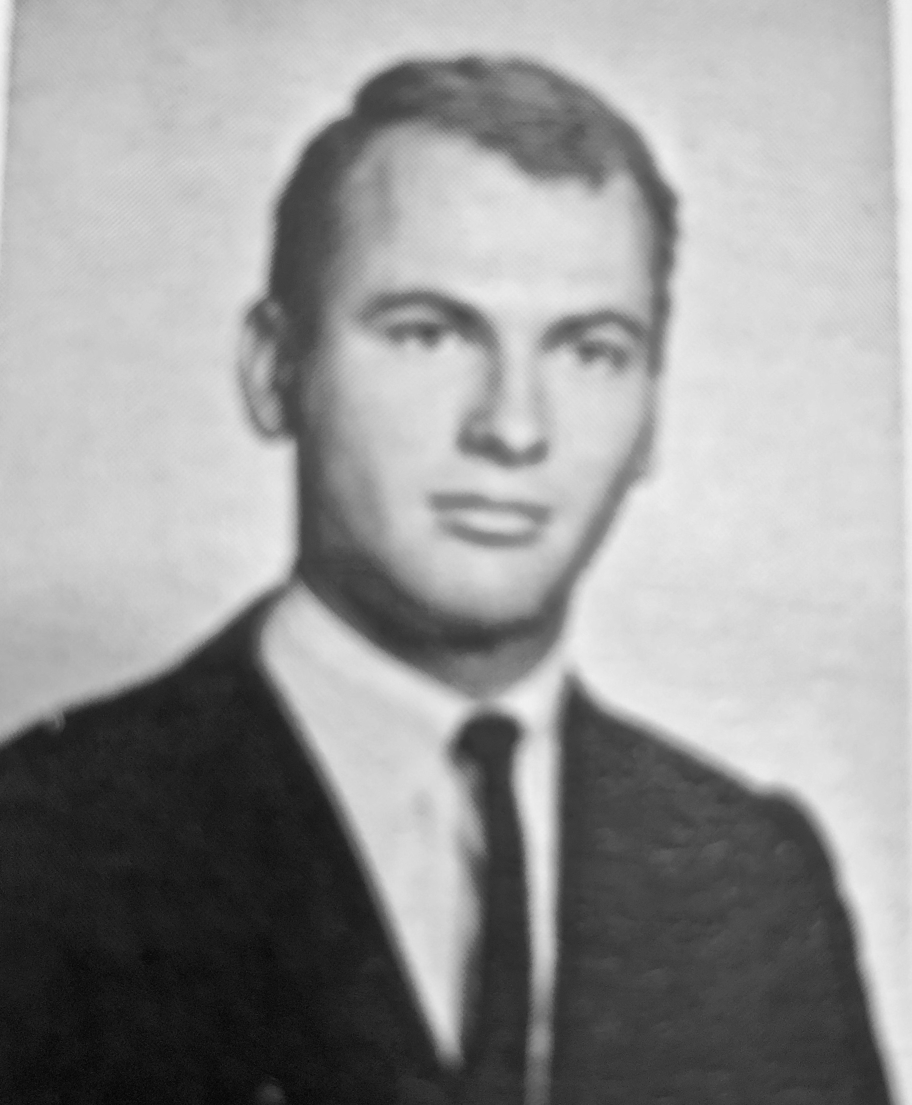
1964
(21)
2012
(70)
2019
(77)

Slide 18
Reactions to, and Descriptions of Transgender Persons
Not a ‘real’ woman or man Freak, weirdo, fag, tranny, shemale (largely in the porn industry) Confused, abnormal, emotionally/mentally unstable Unwitting pawn/recruit of the transgender cabal (typically teens) Attention seeking, exhibitionistic, narcissistic Selfish, reckless, naive Impersonator, fake, deceptive, “a trap” Fetishistic (autogynephilia), perverted Promiscuous in general or ‘just want to have sex with guys/girls’ Transgender is not a ‘real’ gender ‘Gender’ is a fiction; only the male/female sexual binary is ‘real’ Unnatural UnGodly, Satanic Have an agenda (and probably not a very nice one) Playing the identity card Engaging in identity politics Engaging in special pleading (acting like a snowflake) Influenced by ‘social contagion’: Rapid Onset Gender Dysphoria Misgendering: ‘dead’ name, pronouns, form of address (sir, madam)
Notes:
Remember: Marked versus Unmarked
Differential reactions to trans women versus trans men: reflects underlying sexism
Trans women appear more radical because they challenge the dominant male norm, in addition to challenging cis normativity
As part of cis male fetishization of sex, trans women elicit complicated reactions and often arousals (the virtually universal experience of closeted trans women—the sexualization of their GD

Slide 19
Three Models of Intimate Partner Relations
Unconscious relationship: our choice of partners is driven by the desire to resolve the unfinished business of our childhoods
Adult attachment: replicate as an adult the intimate experience of parent and child. Goal is secure attachment: knowing that your partner will be there for you emotionally when you need them
Self expressive: marriage as a means of sublime self fulfillment.
In the last generation women have changed, and men, by and large, have not.
Women now seek intimacy: sexually, intellectually, and above all-emotionally.
For women, giving in and backing off do not work. For men, appeasement and hoping it will just go away also will not work.
Golden Rule of relationship empowerment: “What can I give you to help me get what I want?”
Most reliable predictor of long term martial success: wives clearly communicating their needs and husbands altering their behavior to meet those needs
Notes:
The older model of a caretaker wife and provider husband: under the best of circumstances a compassionate relationship—what about lack of seating of household, parenting chores?
Adult attachment is mammalian: baked in a a deep and fundamental level of the brain
Self expressive: Maslow hierarchy of needs—higher needs require satisfaction of lower needs. Wealth and stronger social institutions led to emphasis on self discovery, self-esteem and personal growth
21st century wives with 20th century husbands
Unless the woman makes disruptive noise, men are happy with the more traditional partnership.
They are however unhappy that their wives are unhappy and cannot figure about how to respond to make things better.
If women back off they will inevitably remain resentful. If men try to appease, women will correctly read it as mere expediency and inauthentic. Plus, since men don’t have any deeper motivation the behaviors will not endure.
Golden Rule: a reciprocal, interactional paradigm; worthy and worth adopting.
My critique: a bit too transactional; more focus on self interest, how to get why I want, rather than on the wants and needs of the partner

Slide 20
Psychologial Patriarchy
Defines the relationship between two different sets of human qualities: results in the halving of the self
‘Masculine’: achievement, strength, dominance, logic, aggression, antidependence, goal orientation, insensitivity
‘Feminine’: weakness, emotion, yielding, dependence, process orientation, oversensitivity
A ‘power over’ relationship model’ as distinct from ‘being with’ A version of ‘zero sum game’ thinking
Raised to be competitive performers, not intimate partners
Use negative coping mechanisms: lashing out, withdrawal or violence, risky health behaviors such as substance use, tobacco
The hubris of viewing ourselves as above our surroundings rather than a part of them.
Notes:
The Masai warrior example: what makes a good warrior? “ I will tell you what makes a great warrior:
when the moment calls for fierceness the good warrior is very ferocious; when the moment calls for kindness, the good warrior is utterly tender. What makes a great warrior is knowing which moment is which.”
Disowning parts of the self; bifurcation; Manhood means clinging to one side and disowning the other
Above surroundings: ecological attitudes

Slide 21
The Primary Obstacle to Change: Male Fragility
What part of your identity have you chosen and what part has been given to you? Will you seek a more authentic version of you?
Questioning of male privilege seems to men like a terrifying loss of core identity: driving force is not misogyny but ‘male fragility.’
Underlying fear of rejection, inadequacy and not knowing what the experience of their female partner really is?
Address the flight from shame into grandiosity. Acknowledge how lashing out, withdrawal, avoidance are used to manage difficult emotions: shame, depression, anxiety, fear, disappointment.
Actively challenge your feelings of being victimized; resist the temptation to move to a one up/better than position.
Develop distress tolerance: this is a more robust idea of ‘strength’
With increasing emotional resilience, seek intimate connection through the cultivation of a loving and generous heart.
Focus on graciously giving your partner the gifts of kindness, emotional support, compassion and sexual pleasure
Notes:
Men are more easily overcome by marital conflict than women
Risk of #MeToo viewing as punishment of a few bad actors: rather need to address the institutional factors that support these actions
Men lead with grandiosity, struggle with covert shame/depression
Manage covert depression through overworking, substance use, lashing out, withdrawal
Feeling victimized, men move from less than to better than: ‘offending from the victim position’
Coming down from grandiosity involves “coming into shame”
Men aren’t simply afraid of intimacy; they’re afraid of subjugation;
Men’s healing focuses on reconnection

